Slide 1
.Net Development for Recruiters

Slide 2
Application Visualization

Slide 3
Application Definition
Wikipedia:
An application software (app or application for short) is a computer software designed to perform a group of coordinated functions, tasks, or activities for the benefit of the user.
Personal addition:
Normally through an UI to interact with and a place to store the user data.
Notes:
Word / Excel / Paint could be examples of applications without a “database”.

Slide 4
Application Layers
General Schema
Data
Presentation
Application / Bussiness / Service
Data Access
DB

Slide 5




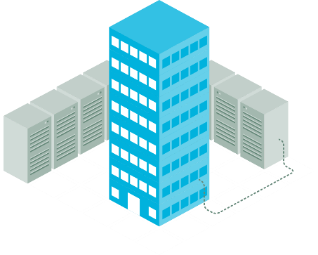

Application Tiers (Physical)
Presentation
Home
Application / Bussiness / Service
Data Access
DB
Datacenter (Cloud)

Slide 6
Application Development Profiles
Frontend
Presentation
Fullstack
Application / Bussiness / Service
Data Access
Backend
DB

Slide 7



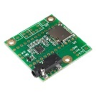

Application Types
Profiles
Web
Desktop
Mobile
Embedded
Services
Presentation
Application / Bussiness / Service
Data Access
DB

Slide 8
App Development with .Net

Slide 9
Frameworks / Ecosystems
Simplify the process of writing code for the developers. Provide a lot of “helper functions” for typical application development tasks. Provide a “standard way” of doing things.
Java
Zen (PHP)
.Net
Symphony (PHP)
Angular
Ruby on Rails
Coldfusion

Slide 10
.Net Languages
When working with .Net you can choose to work in several languages. The most famous / used: C#
C++
J#
C#
VisualBasic
JScript
F#

Slide 11
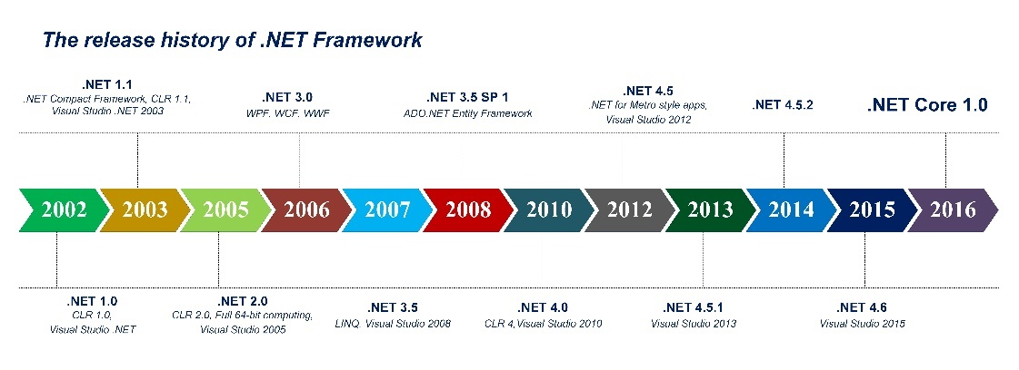
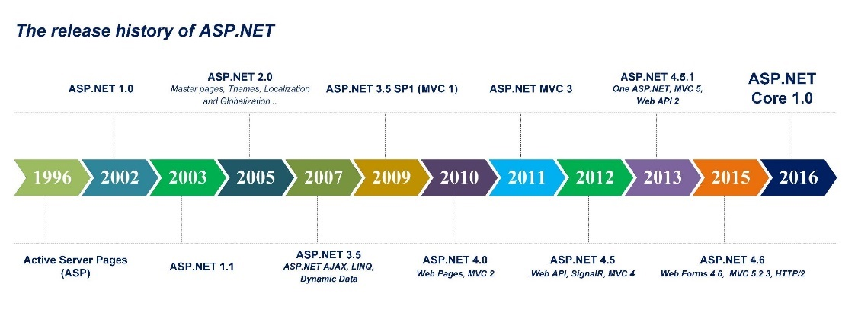
.Net History
.NET 2.0
.NET 3.0
2017
2019
Entity Framework 2.0
Visual Studio 2018
Visual Studio 2019
ASP.NET 2.0
ASP.NET 3.0
2017
2019

Slide 12

.Net Core
The new version of .Net Framework.
Current version 3.1
Faster
Cross-platform: Windows, Linux, Mac
Open source
Modular: not monolithic, use only what you want (nuget packages)

Slide 13

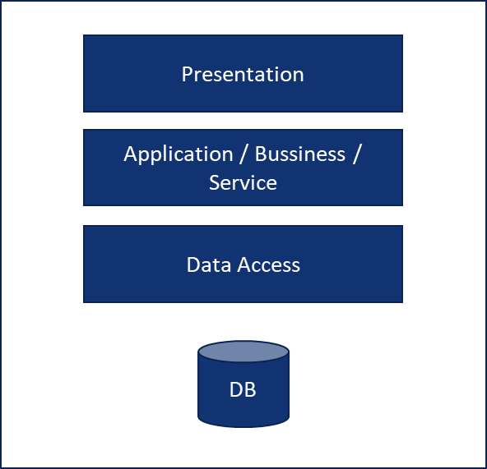


.Net Technologies by layer
Web
Fullstack .Net: MVC, WebAPI, WebForms
Pure Frontend: Angular, React, Vue, npm, webpack…
Standard: HTML, CSS, JS
WPF (XAML), WinFroms,
UWP (XAML)…
Desktop
.Net (CrossPlatform): Xamarin (XAML),
Others (Web-CrossPlatform): Ionic, React Native, PhoneGap, NativeScript, Cordova
Communication
WCF, REST (WebAPI), WebServices, Graph QL, Queues (ServiceBus, RabbitMQ, Kafka…)
Mobile
LINQ, Dependency Injection, Unit Testing, DDD? TDD
Tools
SQL: (relational DBs) SQL Server, Oracle, MySQL,…
NoSQL: MongoDB, DocumentDB, CosmosDB,
Graph DB
DB Access
ORMs: Entity Framework, Nhibernate, Dapper
ADO.NET
Trendy
Current
Database
Old

Slide 14
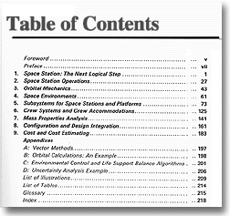

Design patterns (not .Net specific)
High level
(Architecture)
Frontend: MVVM, MVC
Backend: DDD, Microservices, Message Bus
Medium level
TDD, BDD, Dependency Injection (DI/IoC)
Low level
(Patterns)
SOLID principles
(good practices)
Singleton, Facade, Factory, Wrapper, Decorator, Bridge, Proxy…

Slide 15
Development Ecosystem

Slide 16
Tools
Area | Tools | Objective
Source control | GIT, TFS, Subversion, SourceSafe | Share code among developers. All of them editing at the same time. Note: not confuse TFS as a source control tool with TFS as a ALM (Application Lifecycle Management) tool. Note II: Pull request is a specific way to share and approve code working with GIT.
ALM (Application Lifecycle Management) | JIRA, Azure Devops | Tool to organize project tasks for developers. A sophisticated TODO list following the Agile (SCRUM/KANBAN) best practices.
CI/CD | Azure Devops (old TFS), Jenkins, TeamCity, Gitlab… | Tools that allow us to move the application from the developers machines to the “Production environment” (executing automated tests in the middle)
TDD/BDD | Nunit, Visual Studio Unit tests (MSTest), Test Complete, Gherkin, Cucumber,… Related words: mocks, unit tests, DI,… | Allow us to execute Unit Tests; pieces of code that execute the “real code” and checks the behaviour is correct. Note: These tools are integrated in the CI process.
Trendy
Note: Azure Devops (old TFS) is a tool with many usages (can be installed OnPremises or the Cloud). ALM, SourceControl, CI/CD. It tryes to be the “only tool” together with Visual Studio that .Net developers would use.
Current
Old

Slide 17
Tools
Area | Tools | Objective
Dependency Injection (DI) | DI Containers: Unity, Castle Windsor, StructureMap, Autofac, Ninject | It’s a development technique (or “pattern”) that enables US better to use TDD/BDD. NOT having DI normally means NO “good” TDD/BDD (Unit Tests) patterns applied.
REST API | WebAPI, WCF REST, Graph QL | Protocol/Tool/Library normally used to separate the UI (Presentation) from the backend (the rest of layers). Having a REST API is the standard that enables us to separate frontend developers (web, mobile) from backend developers.
Trendy
Note: not misunderstand “DI Containers” with “Containers” (Docker)
Current
Old

Slide 18






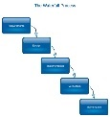
Methodologies
Ways to organize the team work until the delivery
Customer
Agile
(Scrum/Kanban)
Sprint
Waterfall
(Gannt, Microsoft Project)

Slide 19
The cloud

Slide 20



Microservices
My BIG e-commerce
(Distributed systems)
My e-commerce
Products
Customers
Invoices
(Monolith)
Catalog
Logistics
Offers

Slide 21

Scale microservices
My Scaled BIG e-commerce
Catalog
Customers
Logistics
Invoices
Offers
Products

Slide 22

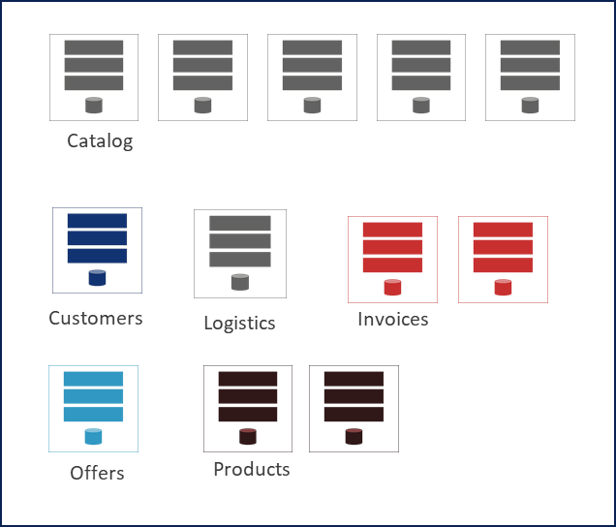



Scale better in the Cloud
ServiceBus, Queues (RabbitMQ)
Continuous Integration
Run & execute tests continuously
Continuous Deployment
After CI: Install in Test Environment
Continuous Delivery
After CD: Install in Production
Communication
CD
Containers (Docker, Kubernetes)
Deployment
Cloud:
AWS
Azure
Google Cloud
Each cloud provider has specific services that a Devops must know
CI
DevOps:
Azure Devops
Gitlab
OpenSource:
Jenkins
TeamCity
Scripts:
PowerShell
Python
Application Insights,
Prometheus, Grafana
Monitoring
Serverless
Buzz words

Slide 23
References

Slide 24
References
Screen .Net developers:
https://devskiller.com/how-to-screen-net-developer-programming-skills-to-find-the-best-guide-for-it-recruitment/

Slide 25
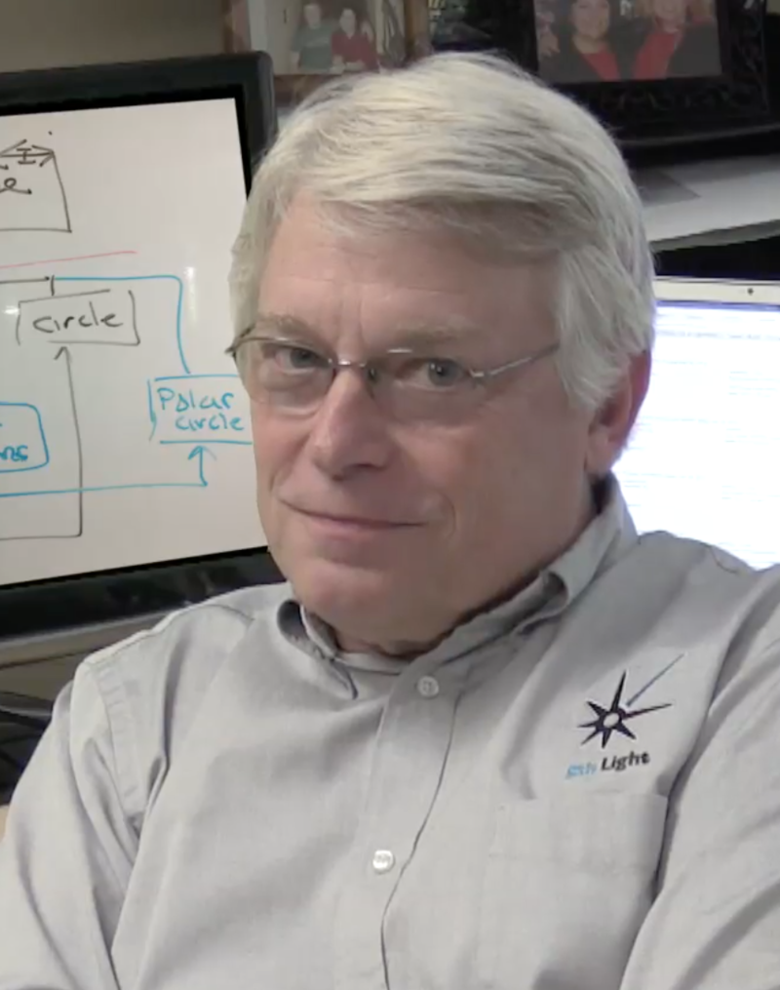


References
Robert C Martin (Agile)
Martin Fowler (SOLID)
Eric Evans (DDD)

Slide 27

Saved images

Slide 28
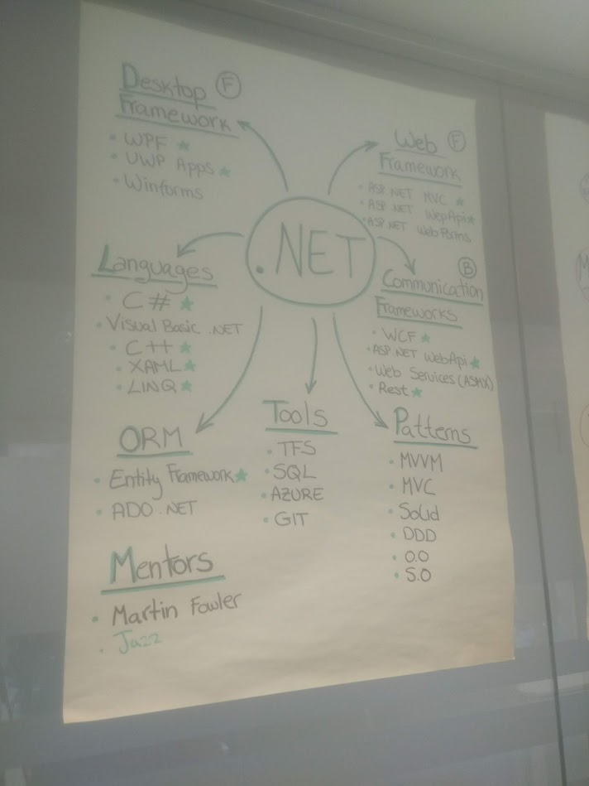

Slide 29
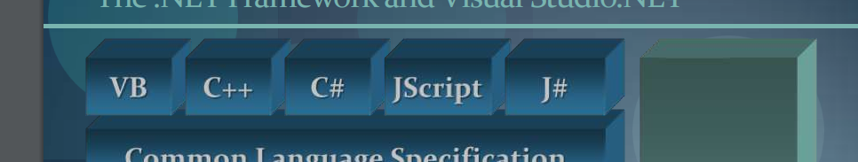
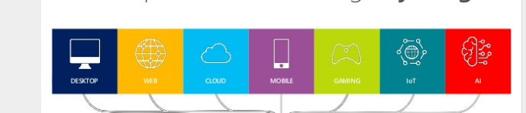
Notes
Languages and others

Slide 30
Sample page with plain text
The author fills the page with his individual texts
This is just a blind text to show how the text runs. Text passages can be highlighted by making them bold (Calibri bold, 90% black).
Intermediate heads are also possible (Calibri bold, dark-blue).
This is just a blind text to show how the text runs. Text passages can be highlighted by making them bold (Calibri bold, 90% black).

Slide 31
Sample page with bullet points
The author fills the page with his individual texts
This is a placeholder for the first bullet point

Slide 32
Sample page with bullet points
The author fills the page with his individual texts
This is a placeholder for the first bullet point
On the second level, the display of the bullet points looks like this
On the third level, the display of the bullet points looks like this
And here is a placeholder for the second bullet point. If the text of a bullet point continues to run, it is automatically broken into the next line.
Place holder for the third bullet point. If the text of a bullet point continues to run, it is automatically broken into the next line.

Slide 33
Sample page with two-column structure
The author fills the page with his individual texts, images etc.
Individual contents (text, graphics, picture, table) for column
All in text format: Calibri light, 14 pt.

Slide 34
Sample page with dark-blue background
The author fills the page with his individual texts
This is a placeholder for the first bullet point

Slide 35
Pattern diagram for copying and pasting
Level 0
Content for this level
Level 1
Content for this level
Level 2
Content for this level
Level 2
Content for this level
Level 2
Content for this level
Logical Group/Level 3
Content for this level
Level 5
Content for this level
Logical Group/Level 3
Content for this level
Level 5
Content for this level
Level 5
Content for this level
Level 4
Content for this level
Level 4
Content for this level
Level 4
Content for this level

Slide 36
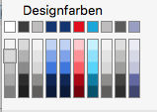
Pattern table for copying and pasting
Header = Calibri bold, 14 pt | Header | Header | Header
Content = Calibri light, 12 pt.

Slide 37
Pattern table for copying and pasting
Header = Calibri bold, 14 pt | Header | Header | Header
Bullet Point Bullet Point .... | Bullet Point Bullet Point .... | Bullet Point Bullet Point .... | Bullet Point Bullet Point ....
Bullet Point Bullet Point .... | Bullet Point Bullet Point .... | Bullet Point Bullet Point .... | Bullet Point Bullet Point ....

Slide 38
Page Layouts
To copy and paste

